Slide 1
introduction

Slide 2
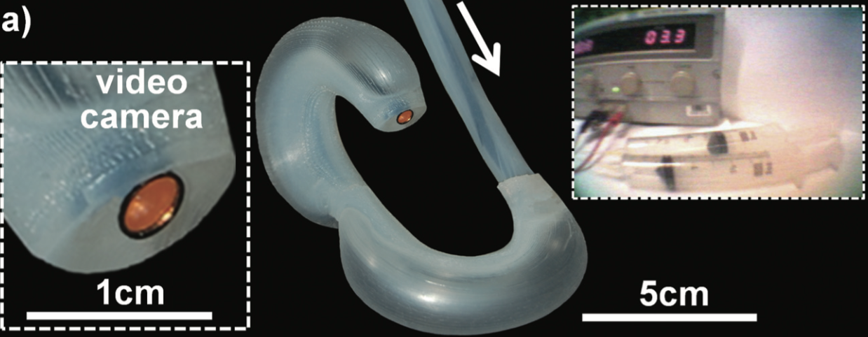
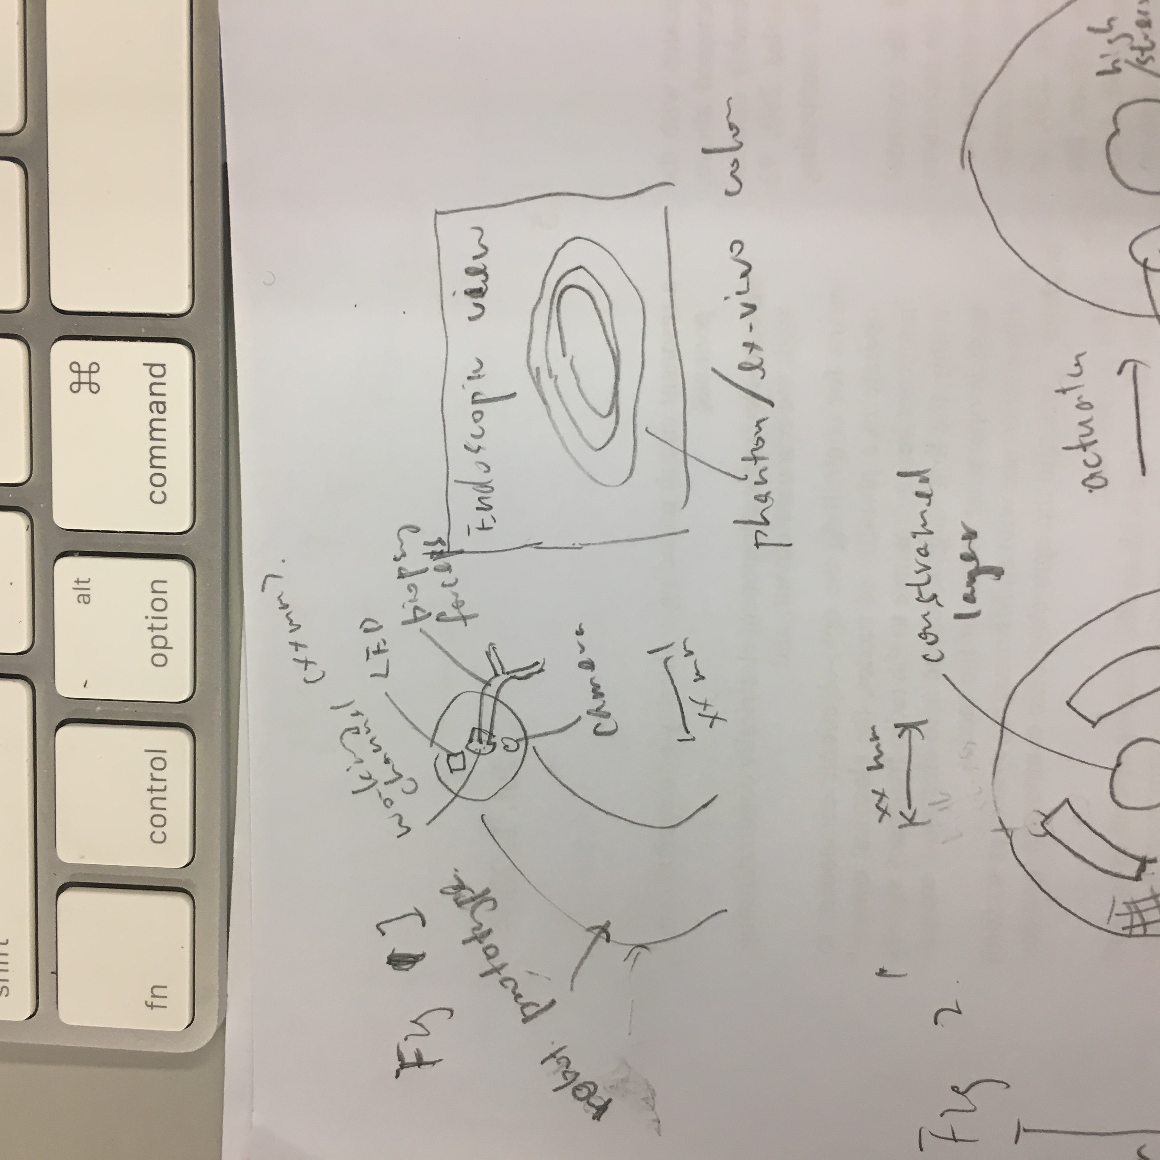
The endoscope prototype.
to give first impression what this paper is about
in the introduction section
with working channel and biopsy forceps
with camera and LED
endoscopic view with biopsy forceps

Slide 3
Methodology

Slide 5
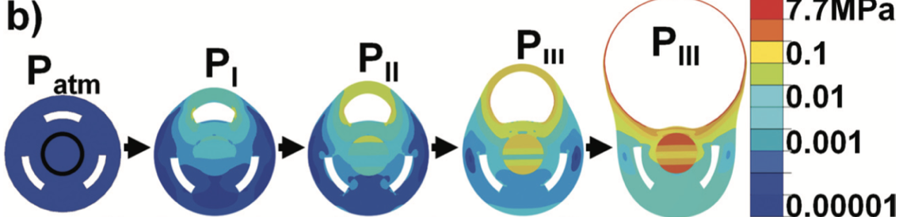
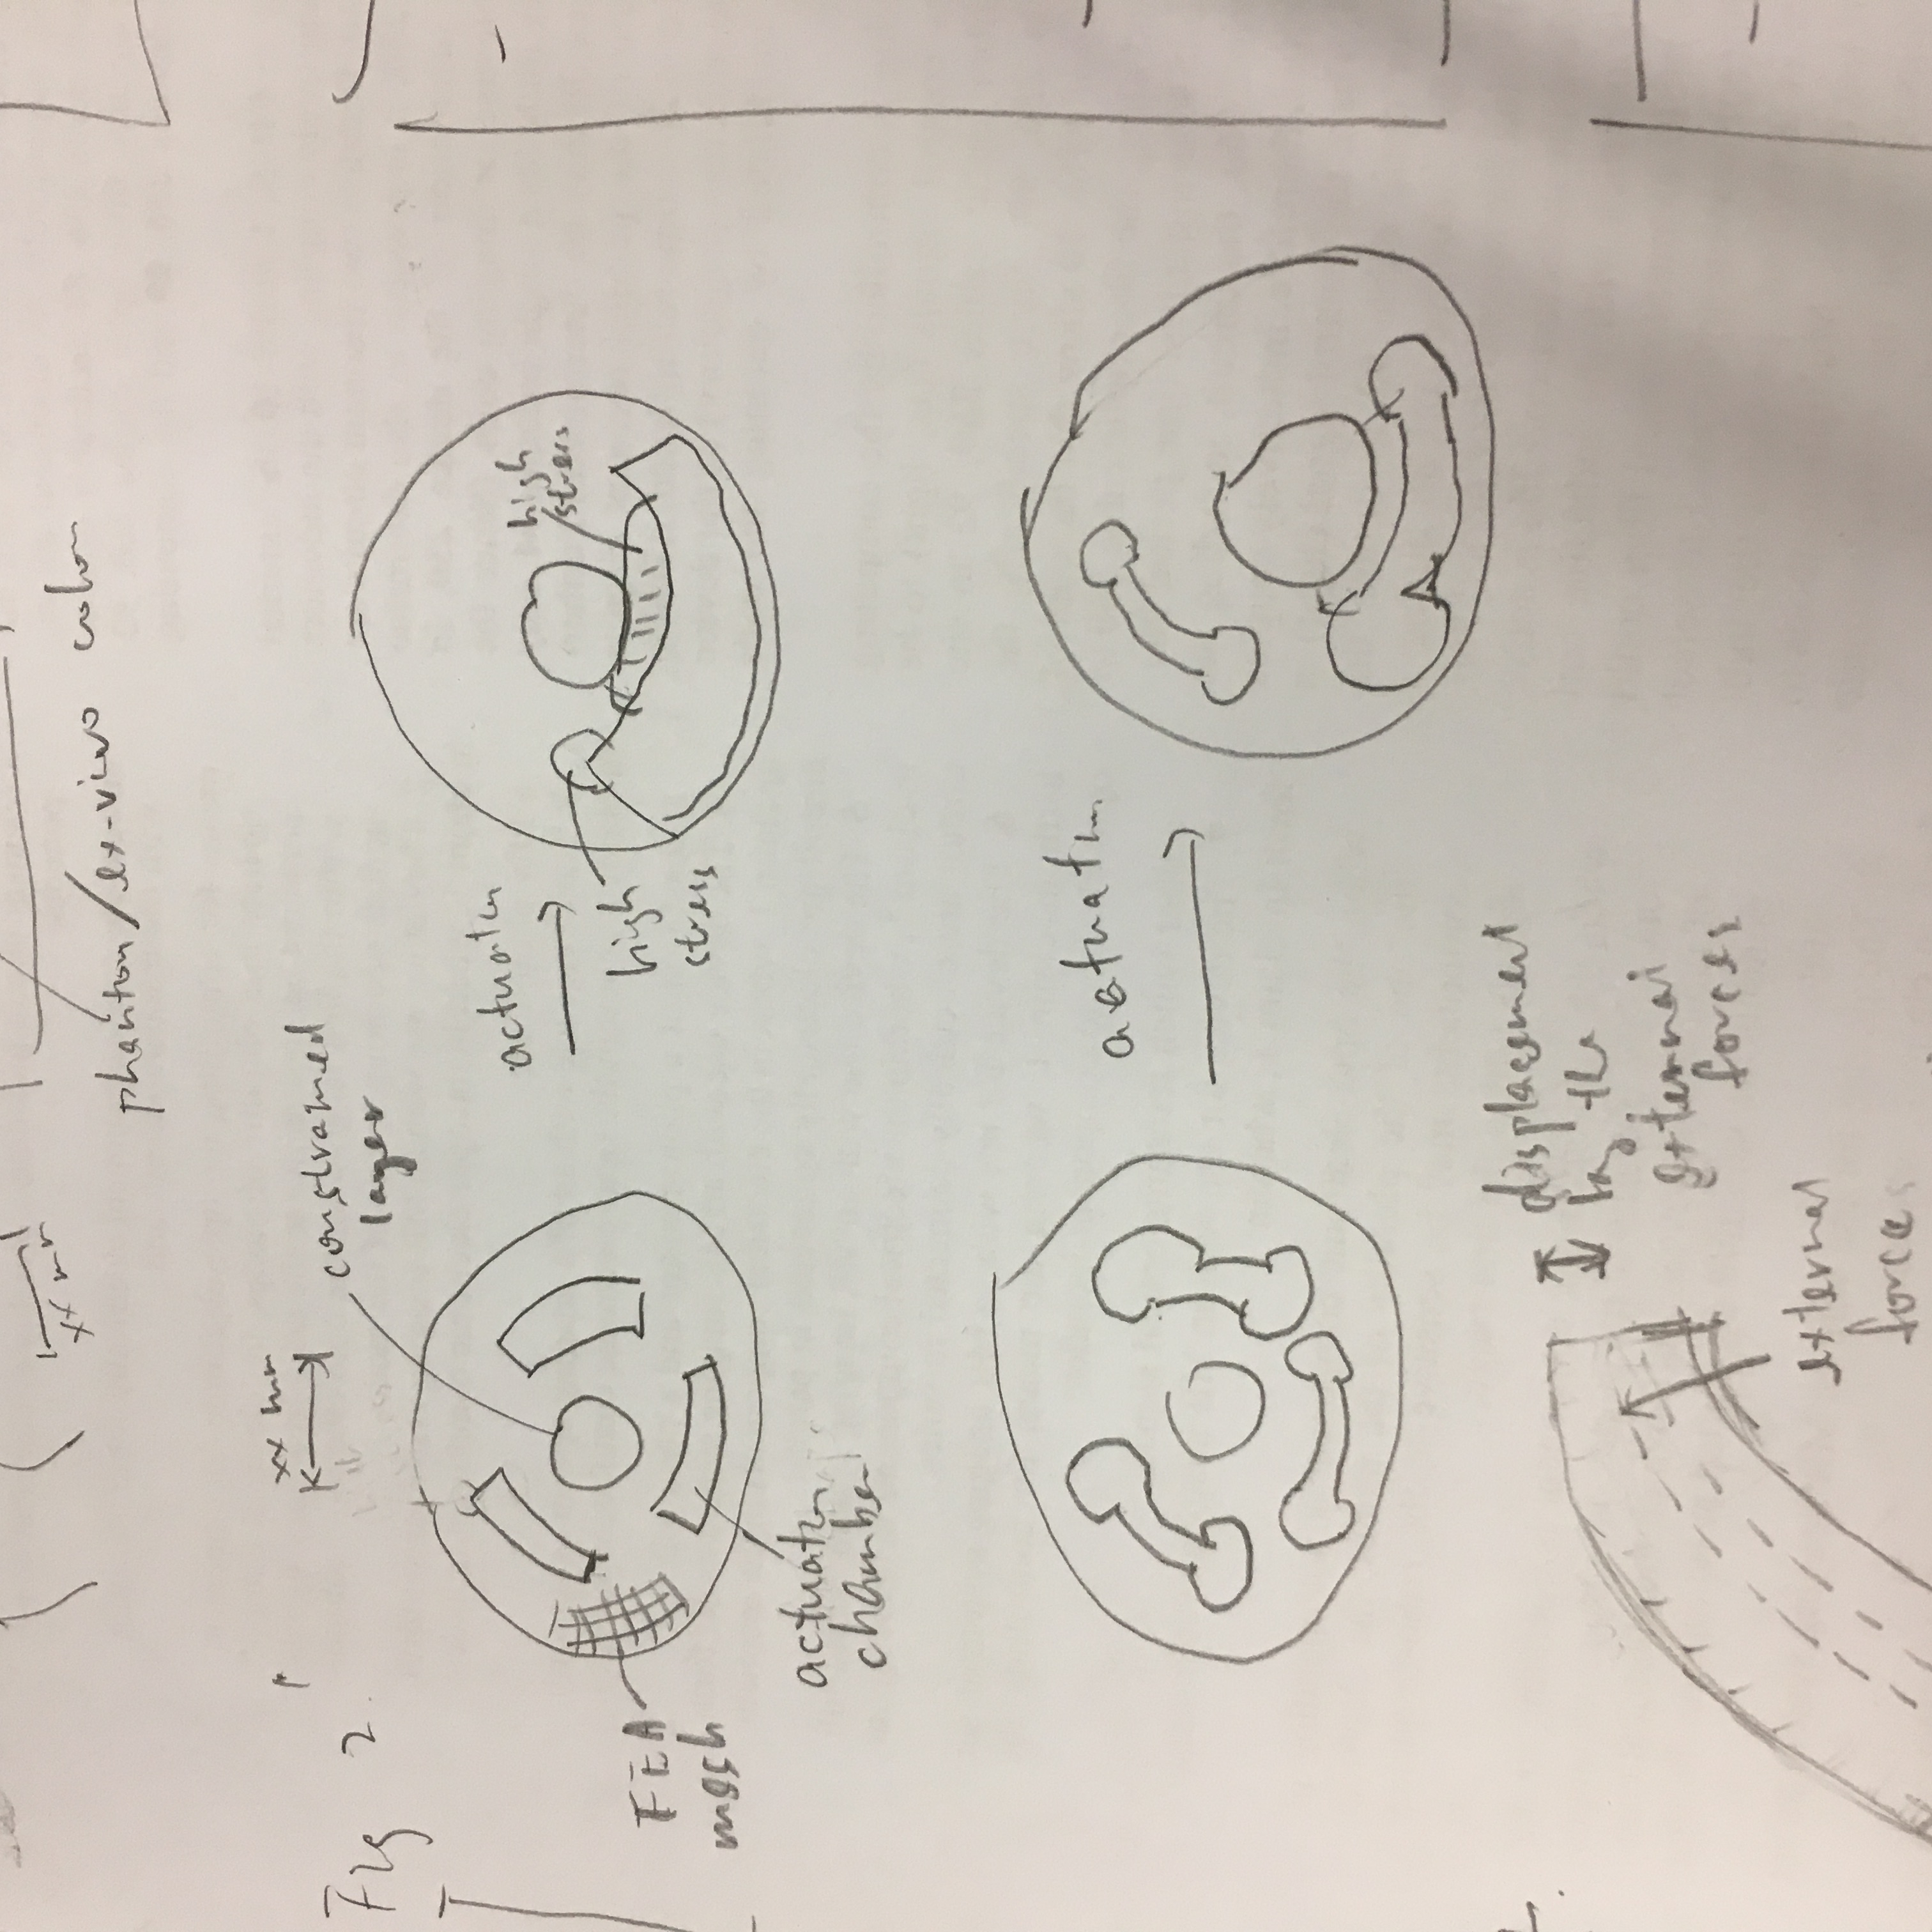
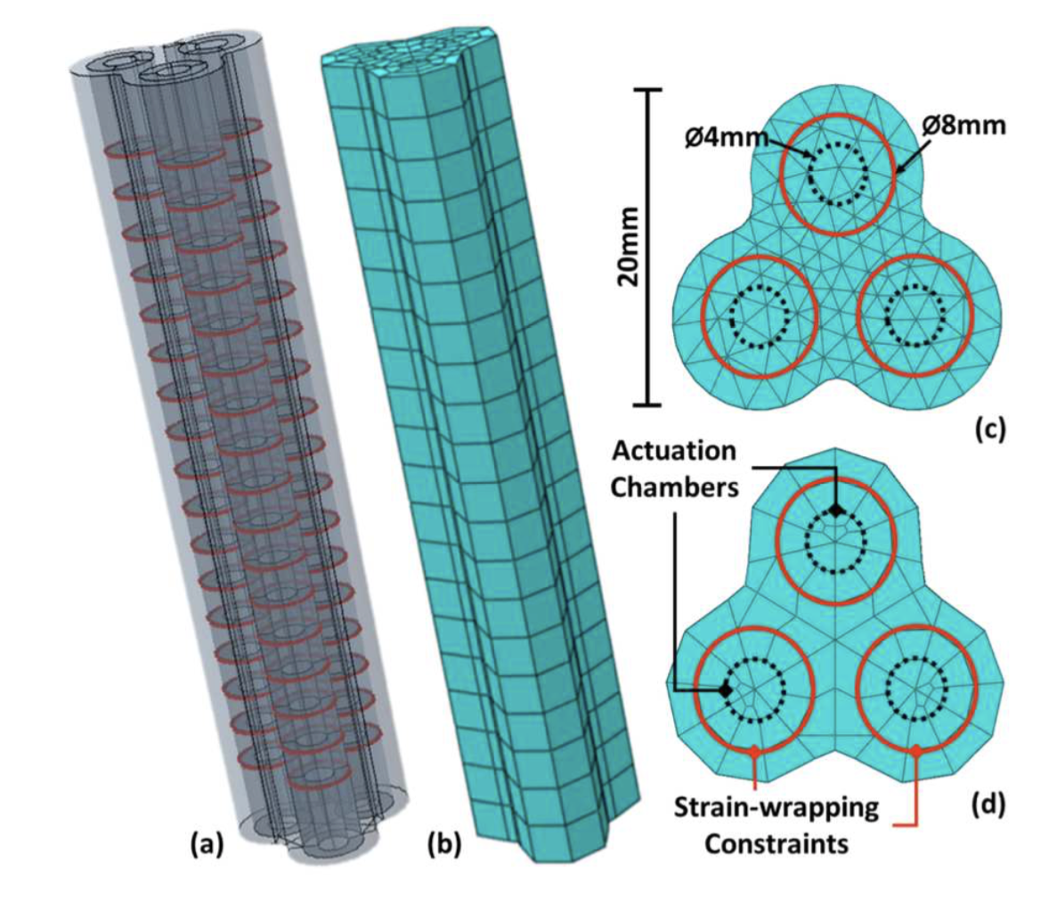
(a)
(b)
showing high stress found at the chamber corners and the wall between the working channel
2D cross-sectional design
to compare the fan-shaped and the dump-bell-shaped design
Internal stress during actuation. (a) Fan-shaped actuation chamber design has higher stress. (b) Dump-bell shaped chamber design has lower stress.

Slide 6
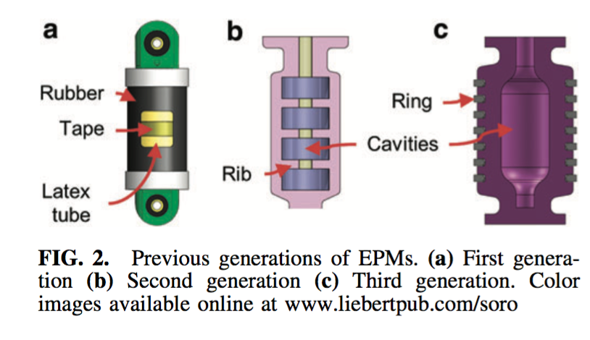
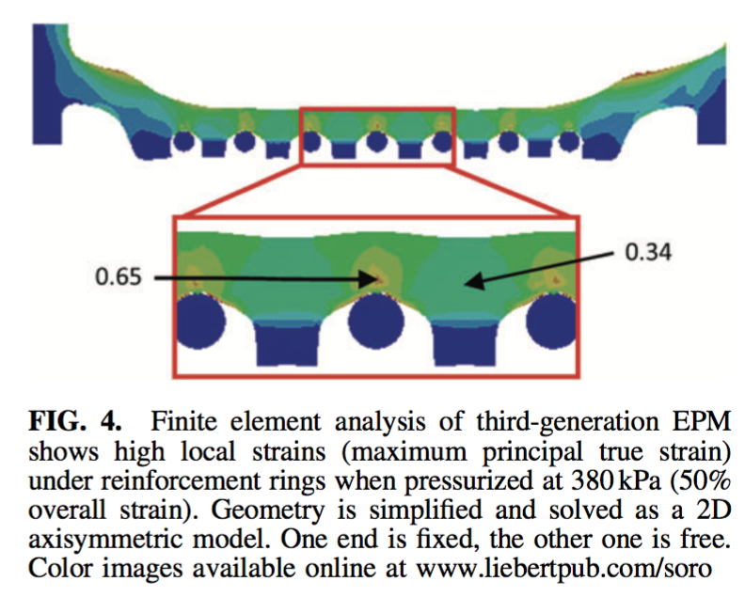
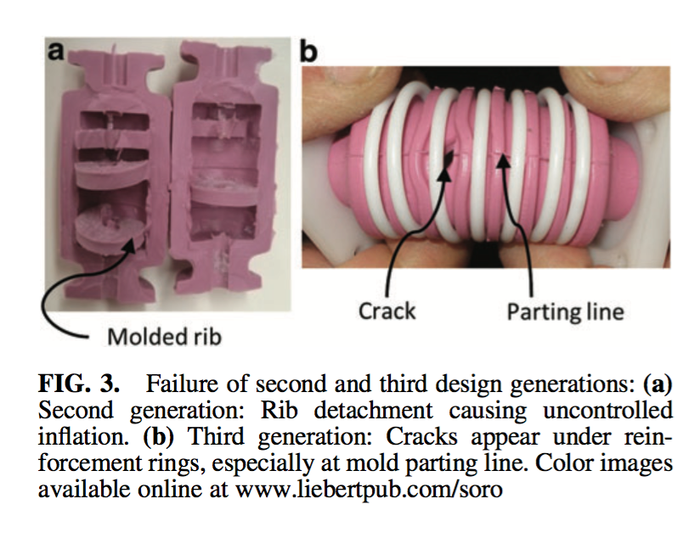
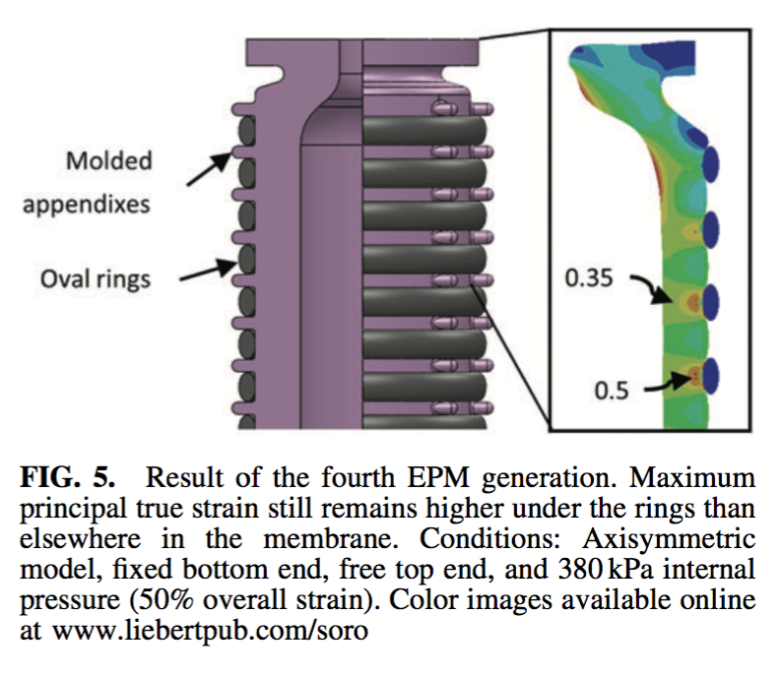
Some literature examples

Slide 7
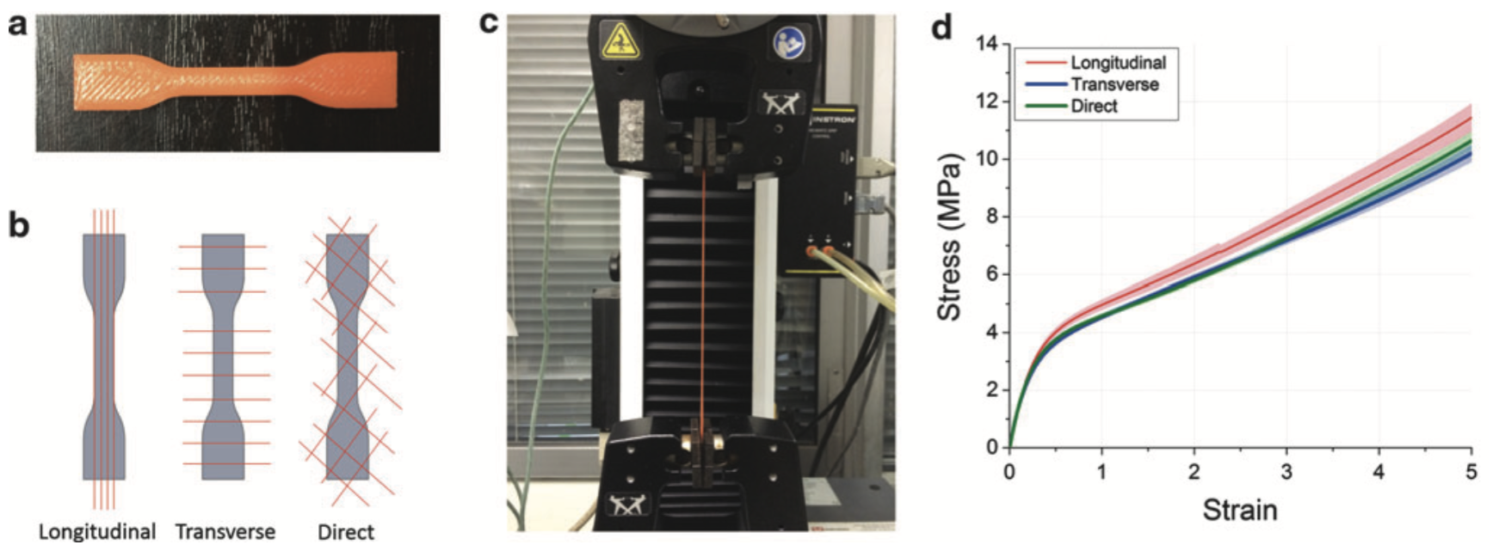
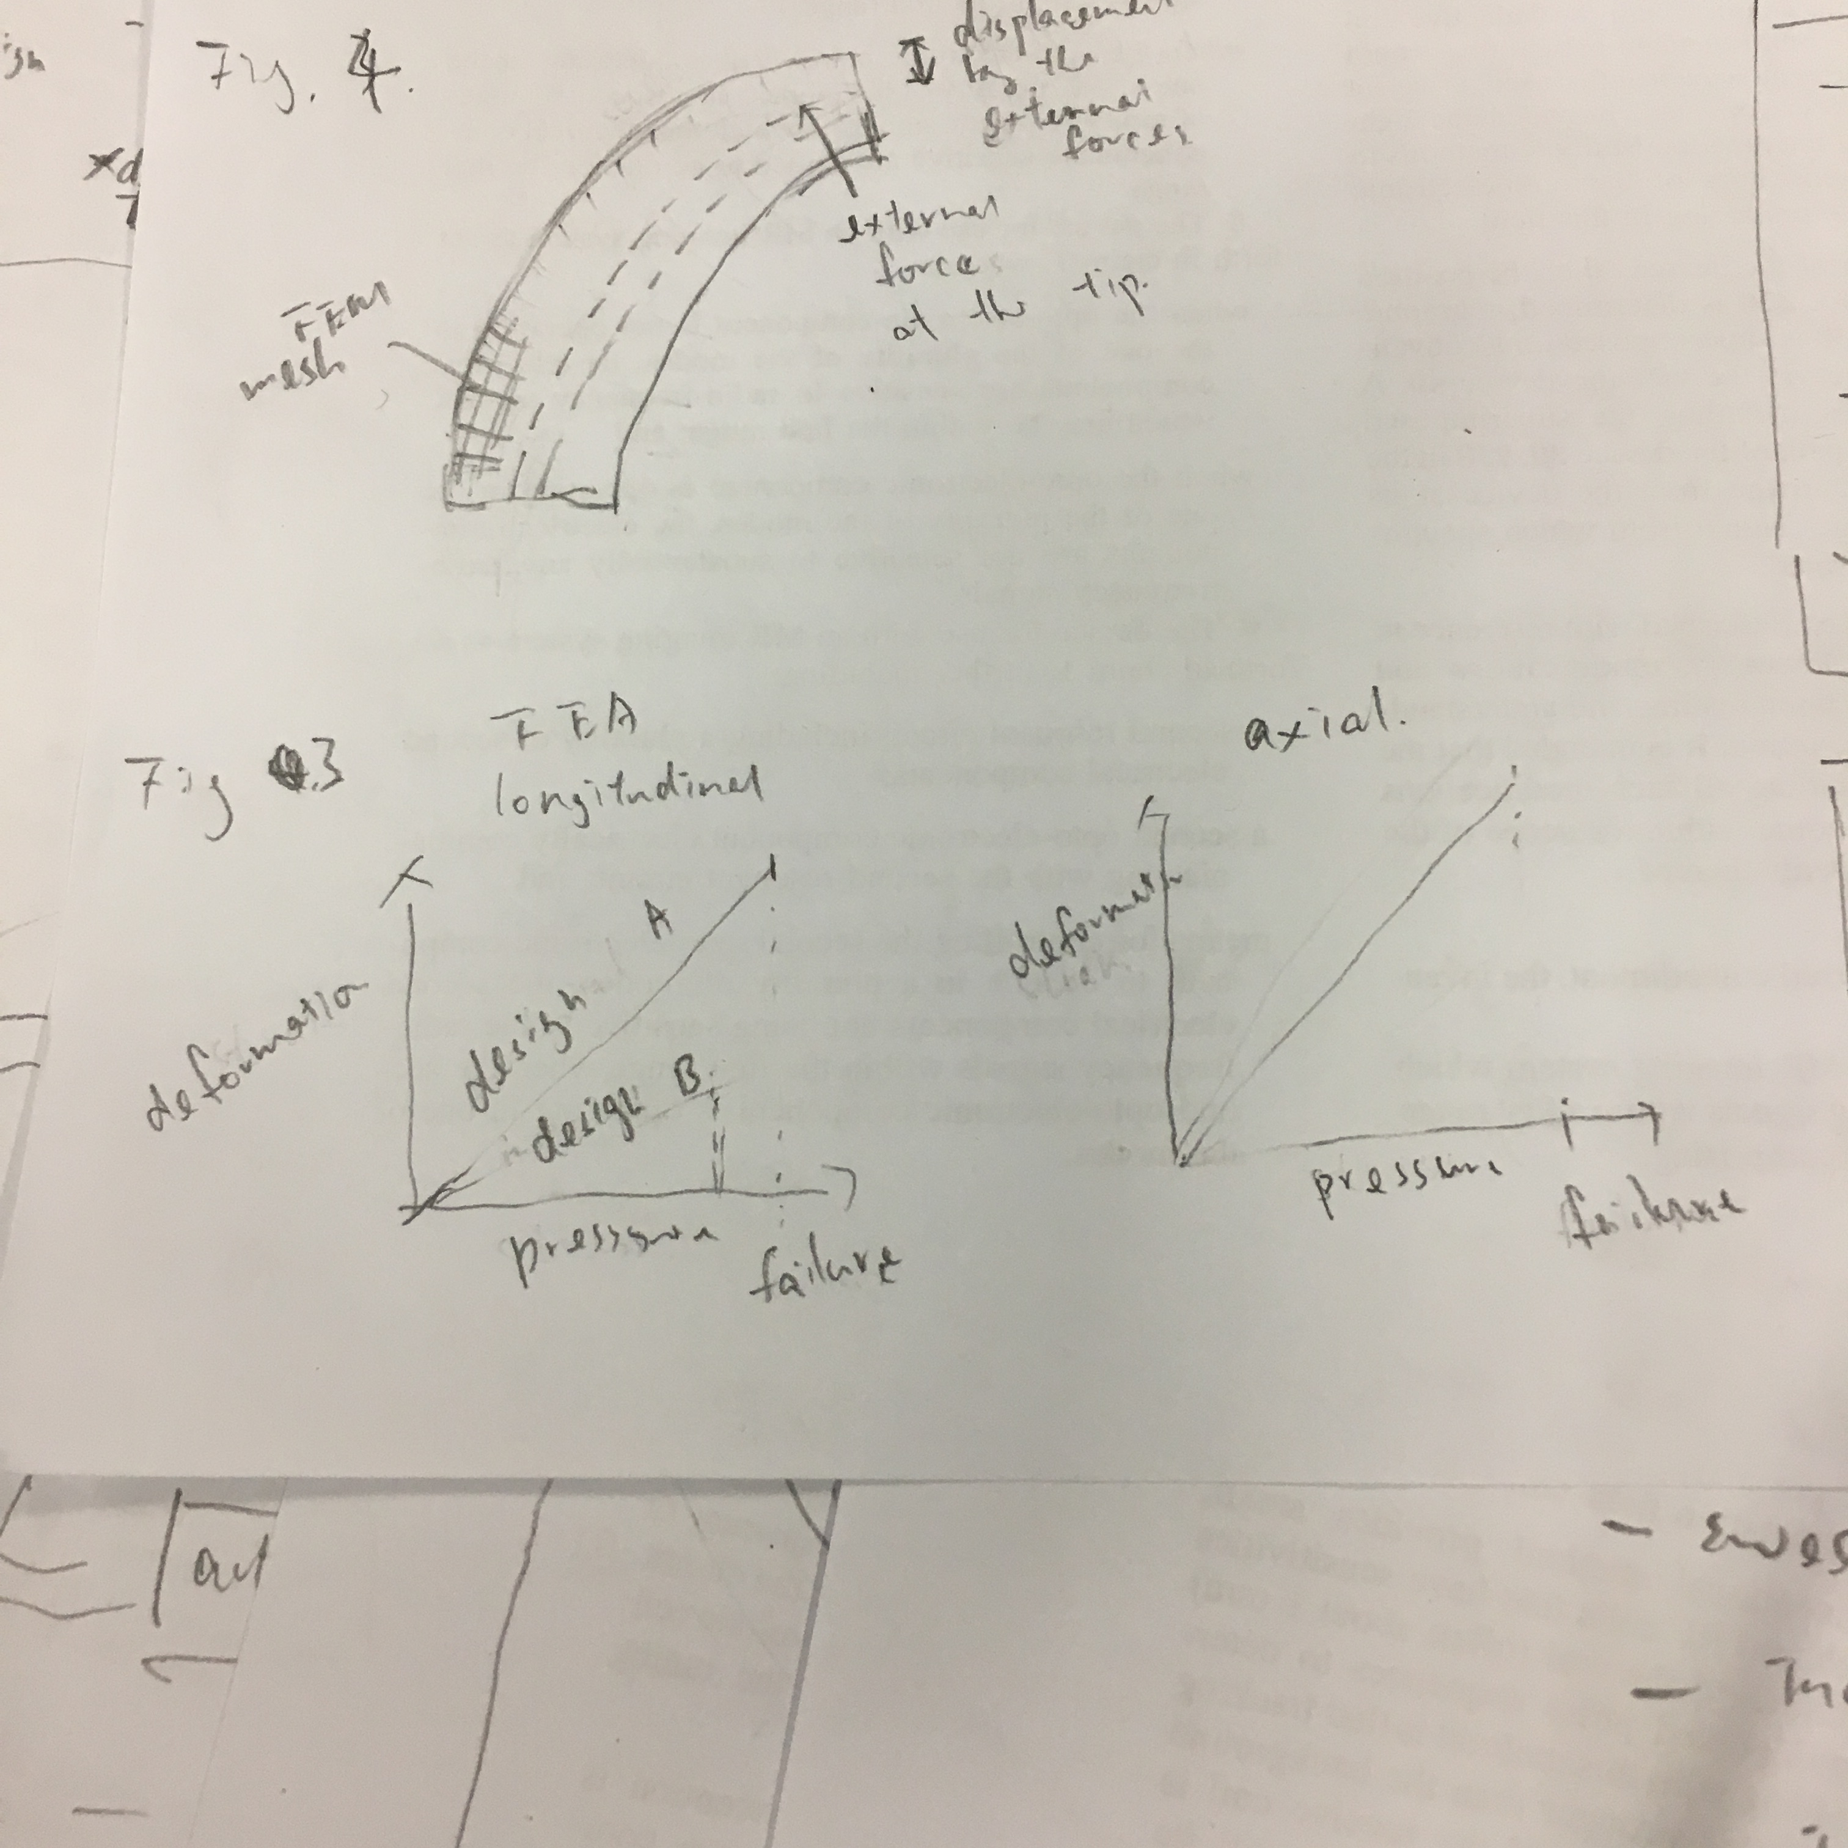
Stress-strain curves of the materials in used. These measurement data are used to identify the correct hyperelastic models in Table [[tab:tab1]].
Stress-strain curves of the materials in used
To show the process of identifying the correct hyperelastic models
To show how high stress the endoscope can sustain before failure
longitudinal, transverse direction

Slide 8
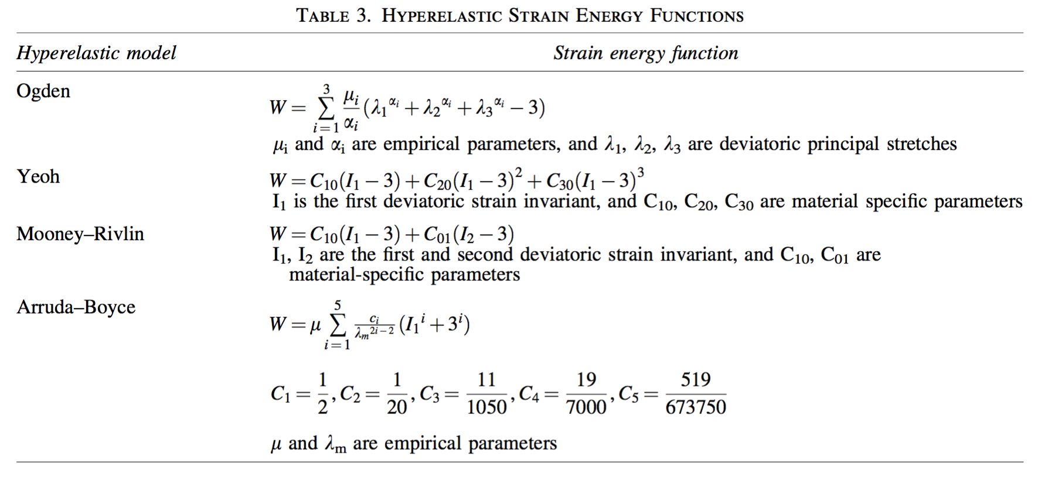
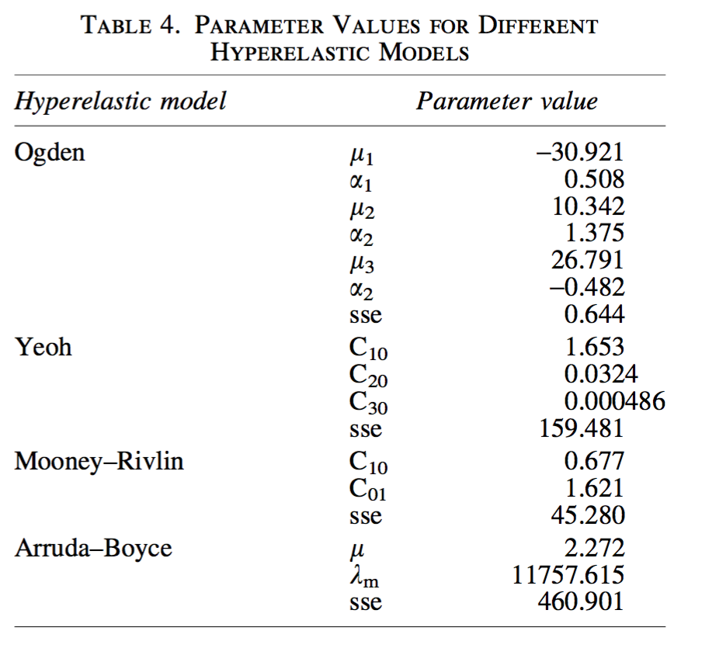
Hyperelastic model candidates for FEM simulation
hyperelastic models
for the choice of FEA formulation (curve fitting)
list several candidates
equations of the corresponding strain-energy functions
FEM simulation parameters.
FEM simulation parameters
to show more details about the FEM simulation
the simulation parameters and the corresponding values for each hyperelastic model
e.g. name of the element in the software
e.g. the number of elements used for simulation
e.g. fitting error, which indicates the best candidate among the hyperelastic models

Slide 9
FEM simulation to estimate the robot stiffness. An external force is exerted at the tip perpendicular to the pointing direction. Stiffer robot requires larger force to move the tip.
Tip displacement
Methodology
How stiff should the robot be?
3D FEA
to show how to examine the stiffness of the whole scope
showing an external force act at the tip
simulate displacement of the tip
force perpendicularly exerted to the tip (center of the cross section)
to show the setting only, result will be shown in the result section
External force at tip
Buckling of central channel?

Slide 10
Can we also simulate the buckling of the internal tubings?

Slide 11
What are the design parameters evaluated by FEA?
We evaluate different structural designs using FEA
Different dimension of internal chambers
Different length
(Different material)
We evaluate only one design
Single dimension, length and materials
 | Method section | Result section | Discussion section
1 | FEA shows the advantages of dump-bell-shaped chamber FEA as reference to optimize structural design parameters | Display different structural design results | Discuss advantage of FEM for optimization of structural parameters
2 | FEA only shows the advantages of dump-bell-shaped Need a rationale to support why the single set of structural design parameters is chosen | Only Evaluate the chosen design

Slide 12
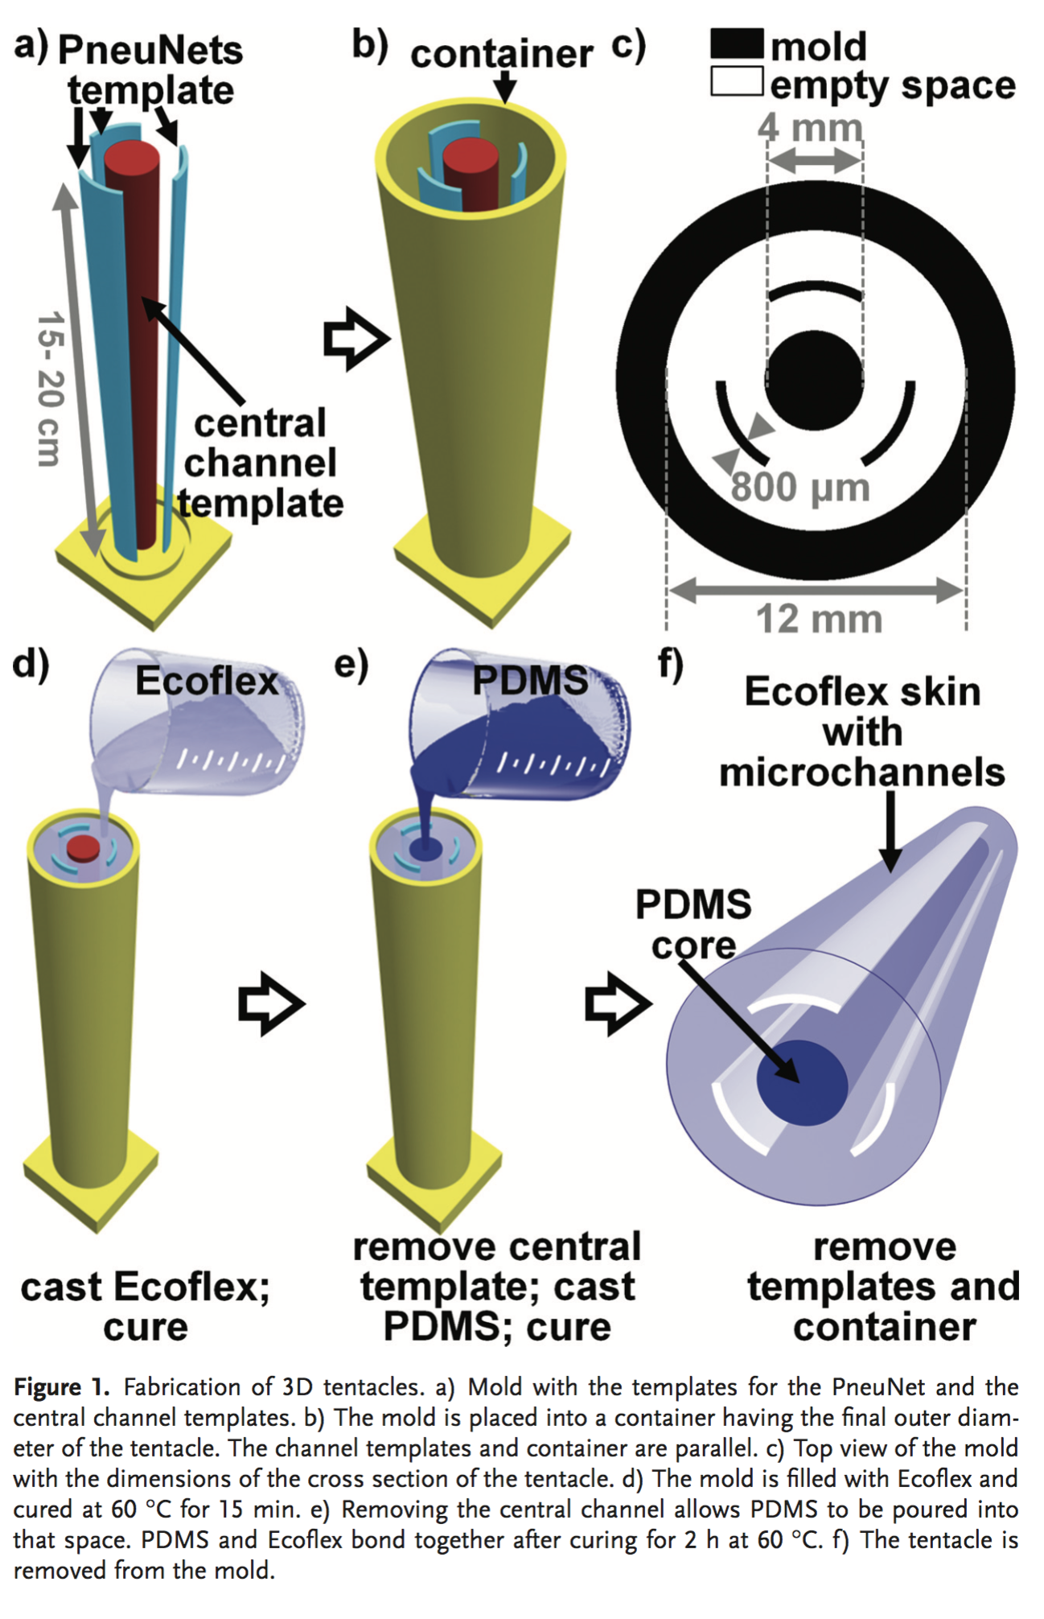
Fabrication procedure of the endoscope prototype. - optional
(Figures of fabrication procedure) - optional
photos or schematic diagram
sequence of fabrication
molding
the material pouring sequence
temperature condition

Slide 13
Results

Slide 14
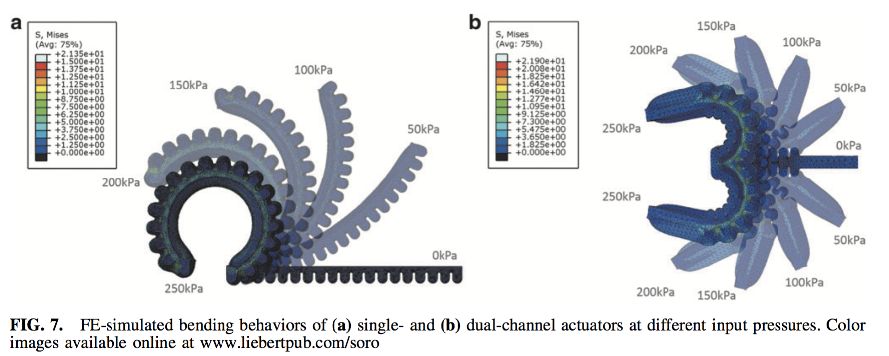
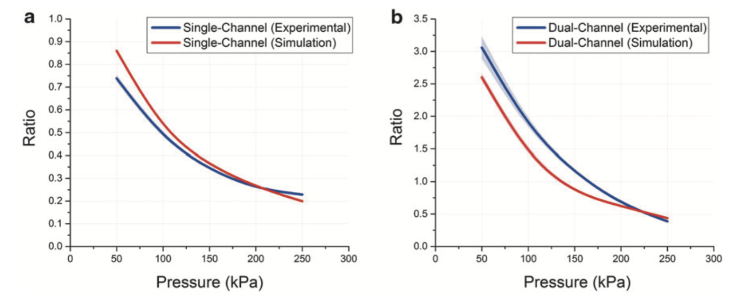
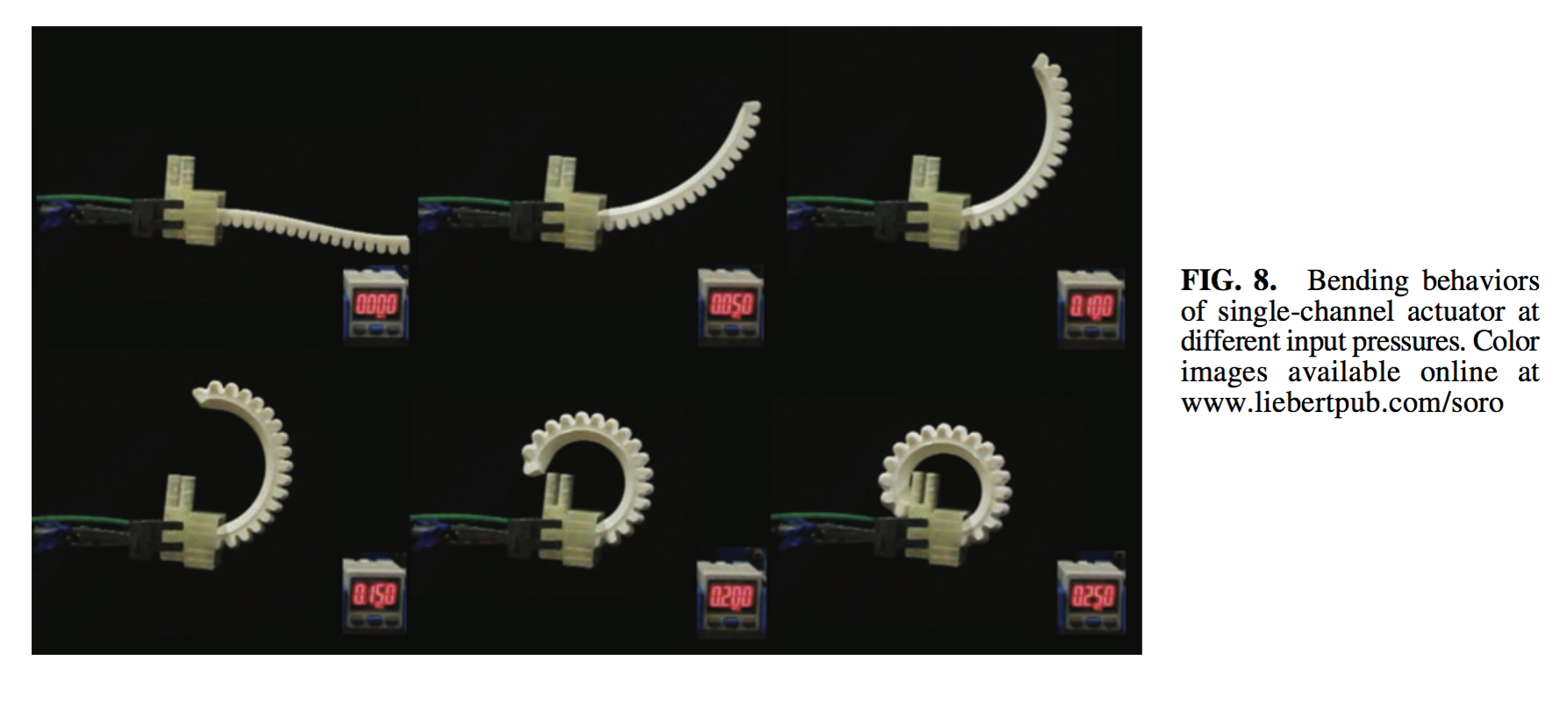
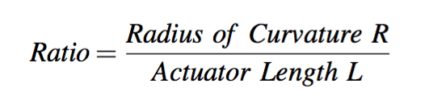
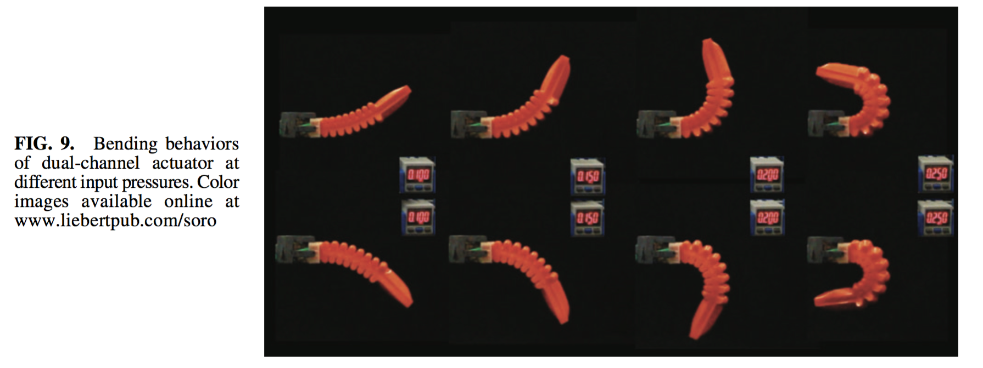
Bending behavior of the endoscope. (a) FEA results with different chamber pressure. (b) Snapshots of the real robot. (c) The relationship between chamber pressure and the bending curvature, for different preloaded pressure (and designs). (d) Bending coplanarity of the prototype. (e) Workspace of the prototype
(a)
(b)
(c)
Bending behaviour
bending curvature vs pressure
curvature ratio = radius/length
Bending coplanarity
Workspace analysis
conditions
bending when actuating 1 and 2 chambers
different preloaded pressure
different designs (e.g. chamber cross-section area)
Validate the FEA data by real robot data

Slide 15
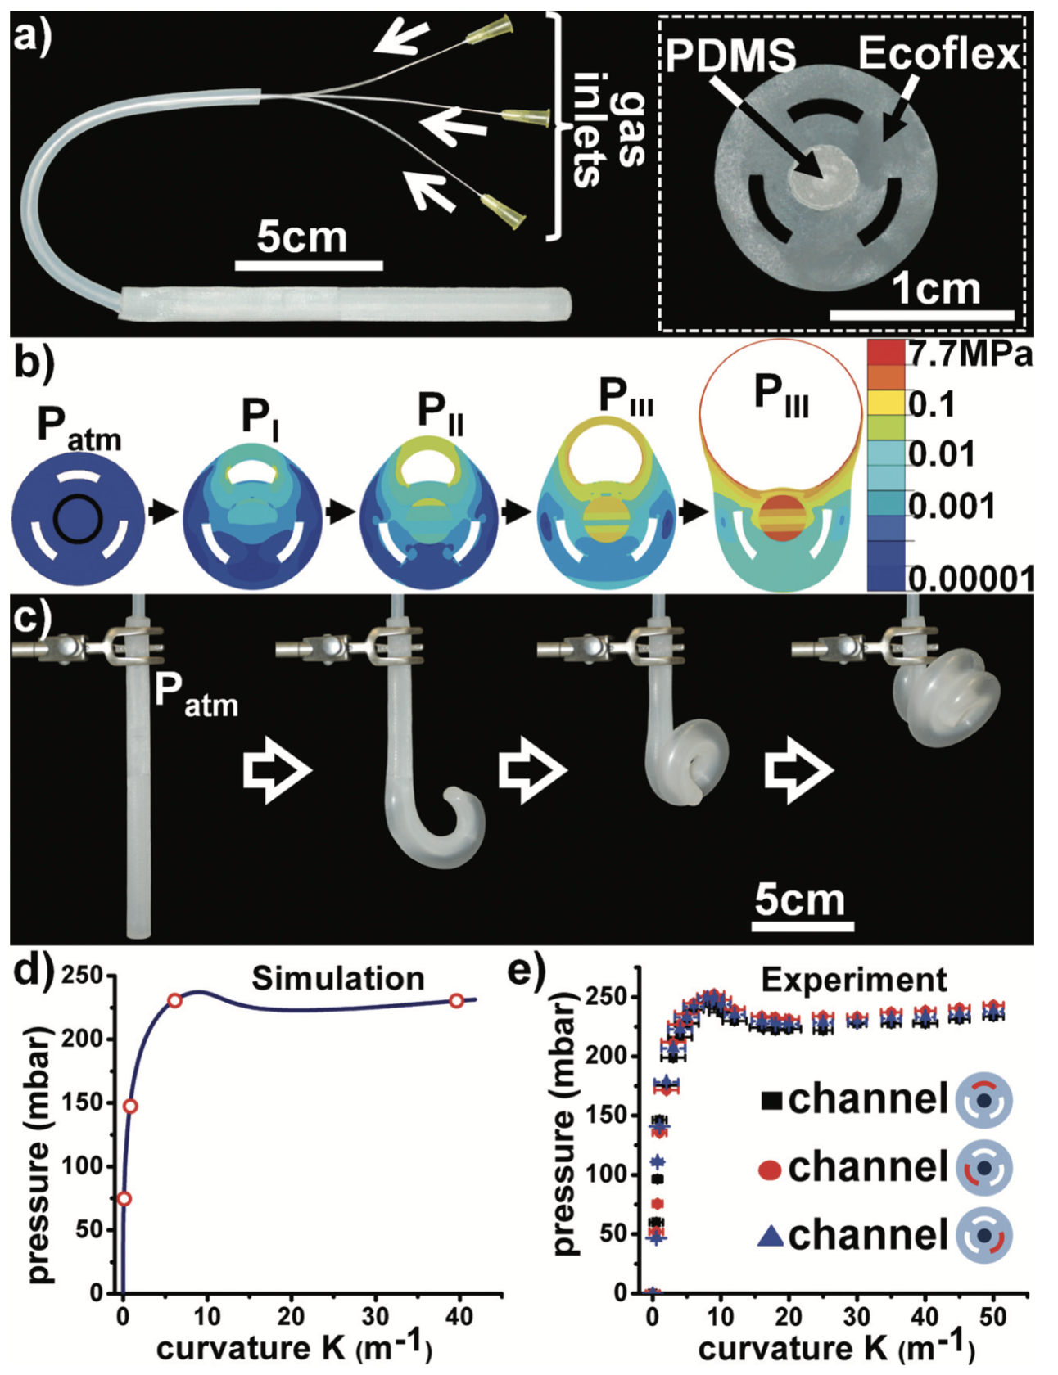
Examples

Slide 16
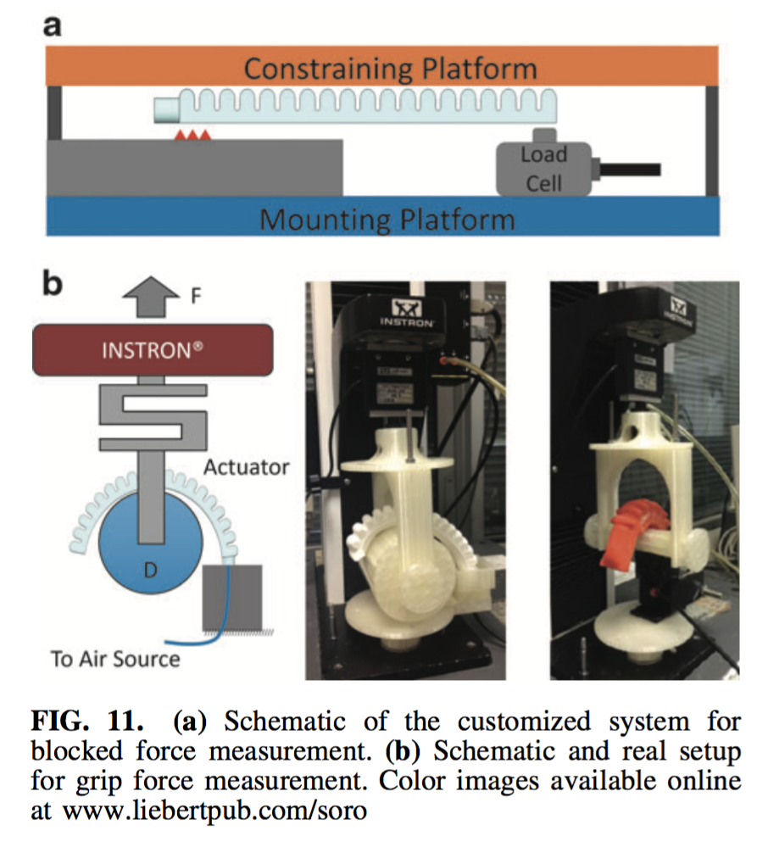
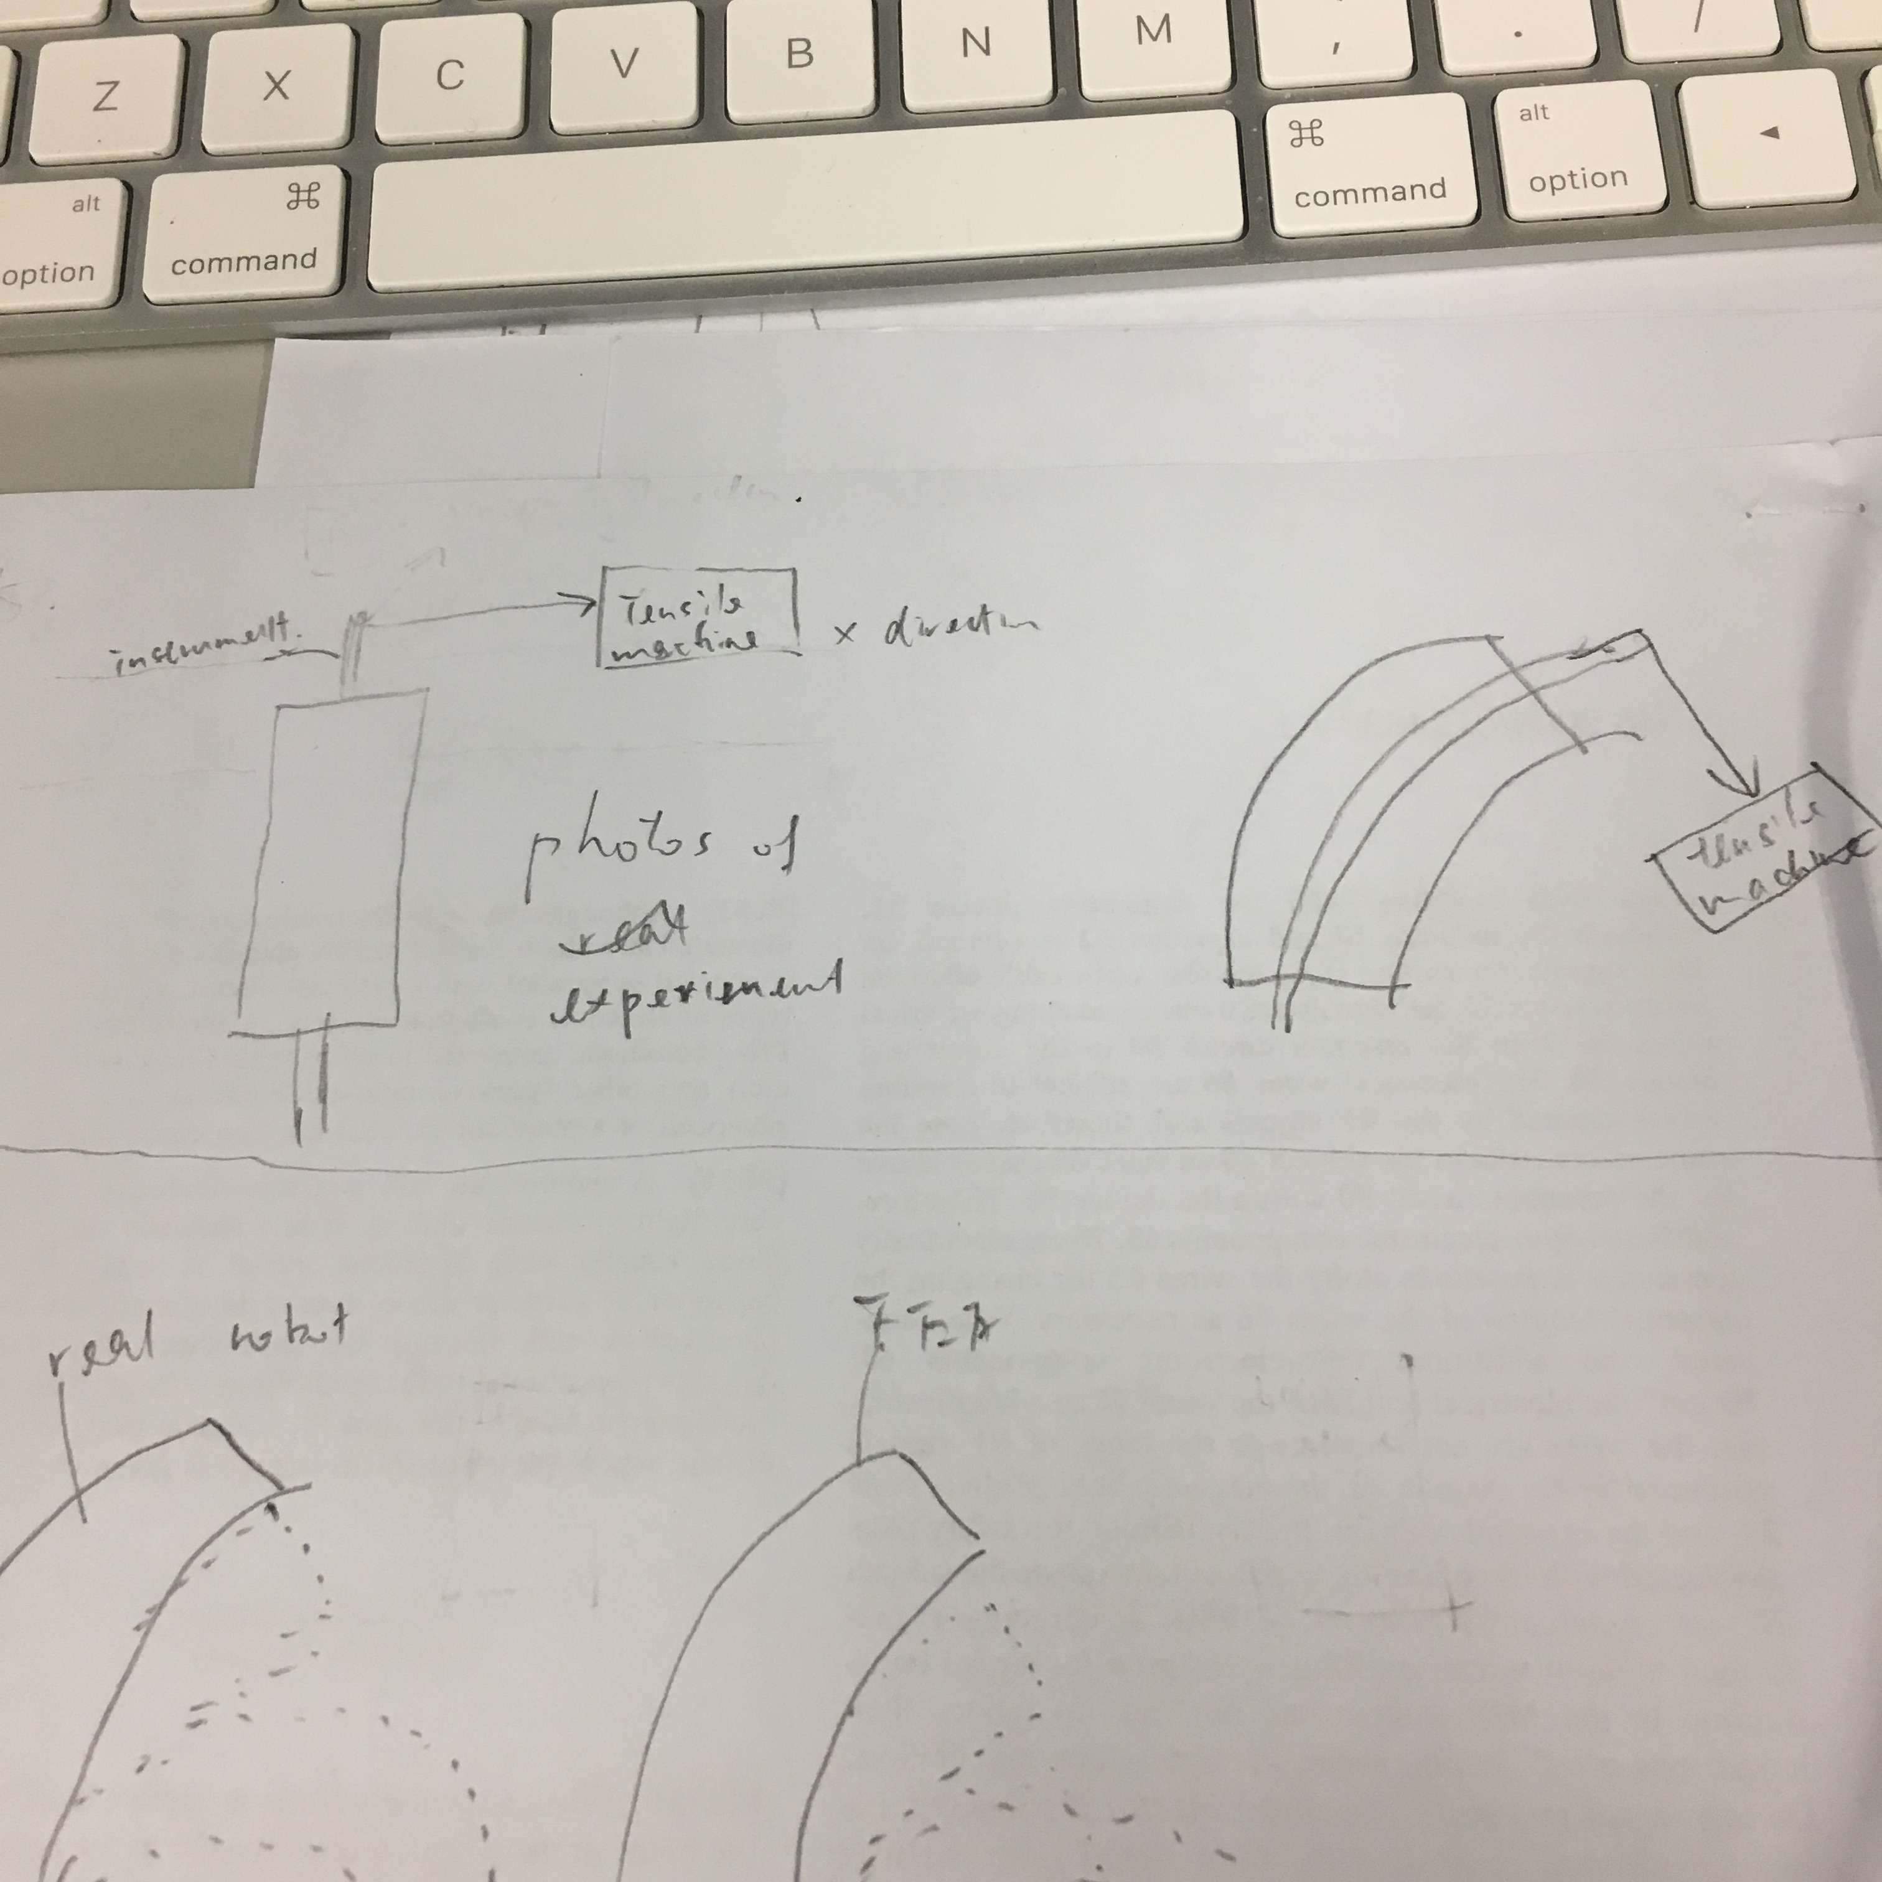
Stiffness measurement setting. The tip of the robot is connected to a pulling device with a force sensor. The robot is fixed to a platform. The platform is tilted to ensure the force is exerted perpendicular to the pointing direction.
Experiment setup
Measuring the stiffness of the prototype
to show the measurement setting for
1) the actual bending behavior and
2) the stiffness of the prototype (tip force until displacement)
robots with camera, working channel and LED
bending when actuating 1 and 2 chambers
different preloaded pressure

Slide 17
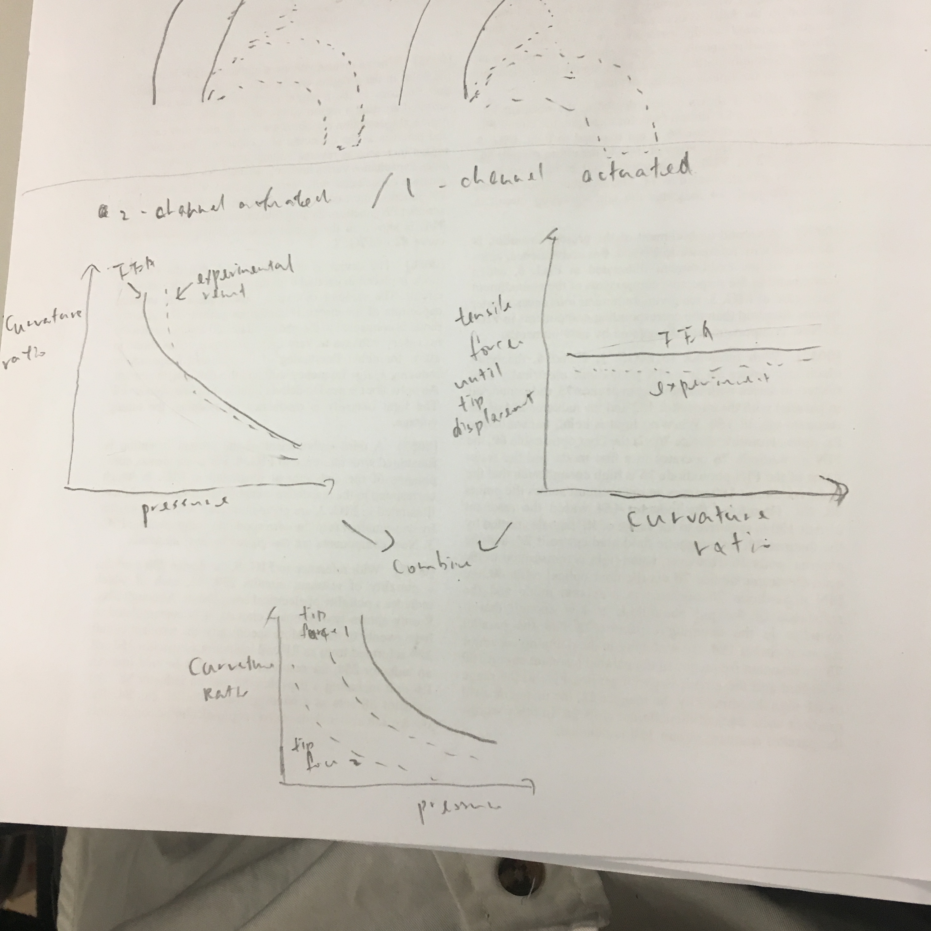
Stiffness of the protoype. (a) The min. force required to move the tip for Xmm vs curvature ratio, for different preloaded pressure (and design). This force indicates the stiffness of the prototype. (b) The maximum displacement of the tip when accelerating a biopsy forceps inserted in the central channel.
(a)
Stiffness results
min. force to displace the tip vs curvature ratio
max displacement of the tip when accelerating a biopsy forceps
condition
at different static bending angles
actuation of 1 or 2 chambers
preloaded pressure
Validate the FEA data by real robot data
(b)

Slide 18
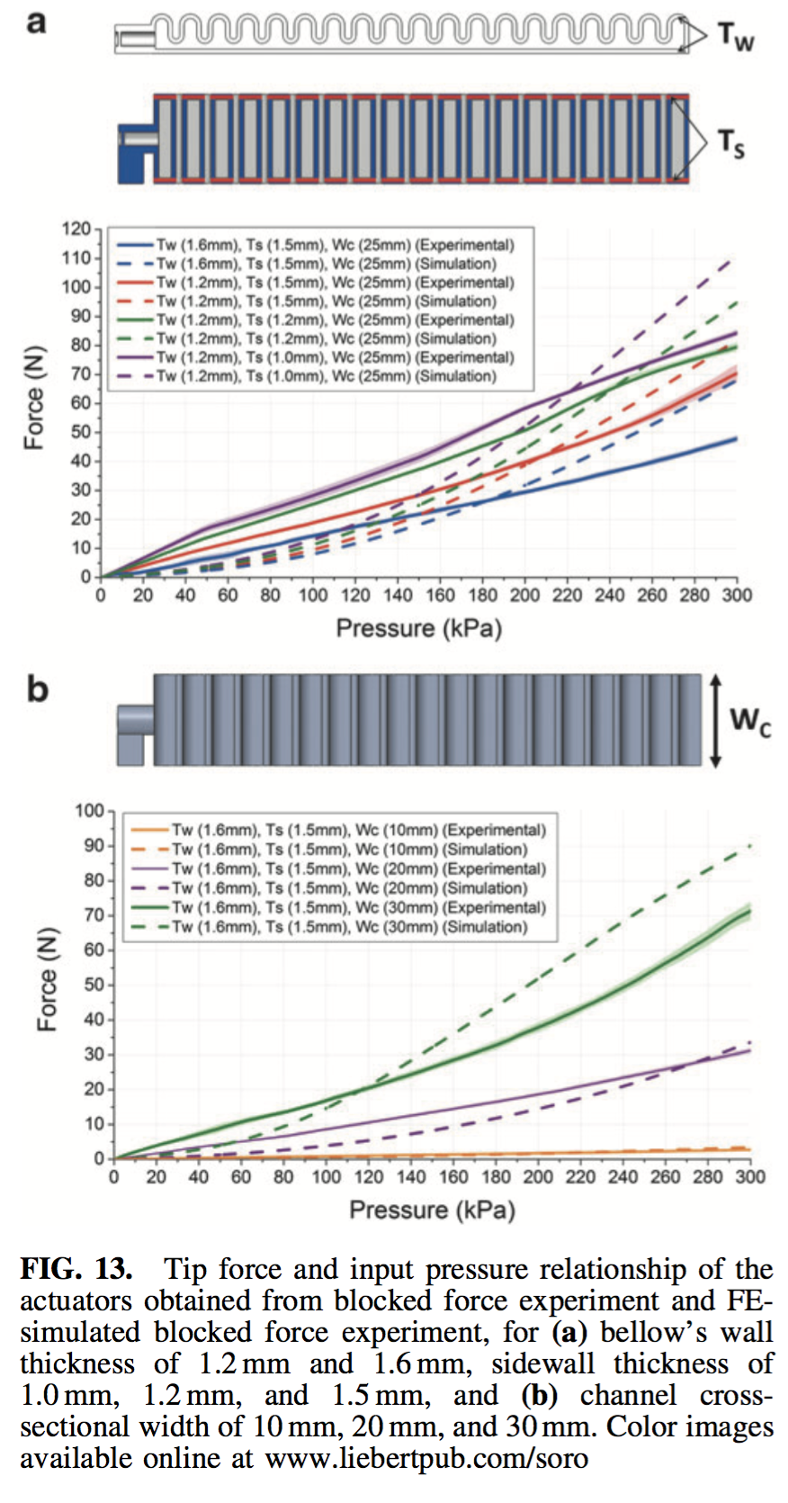
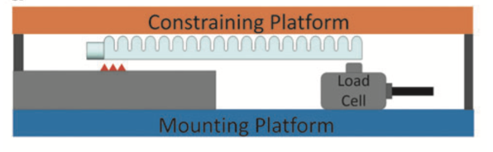
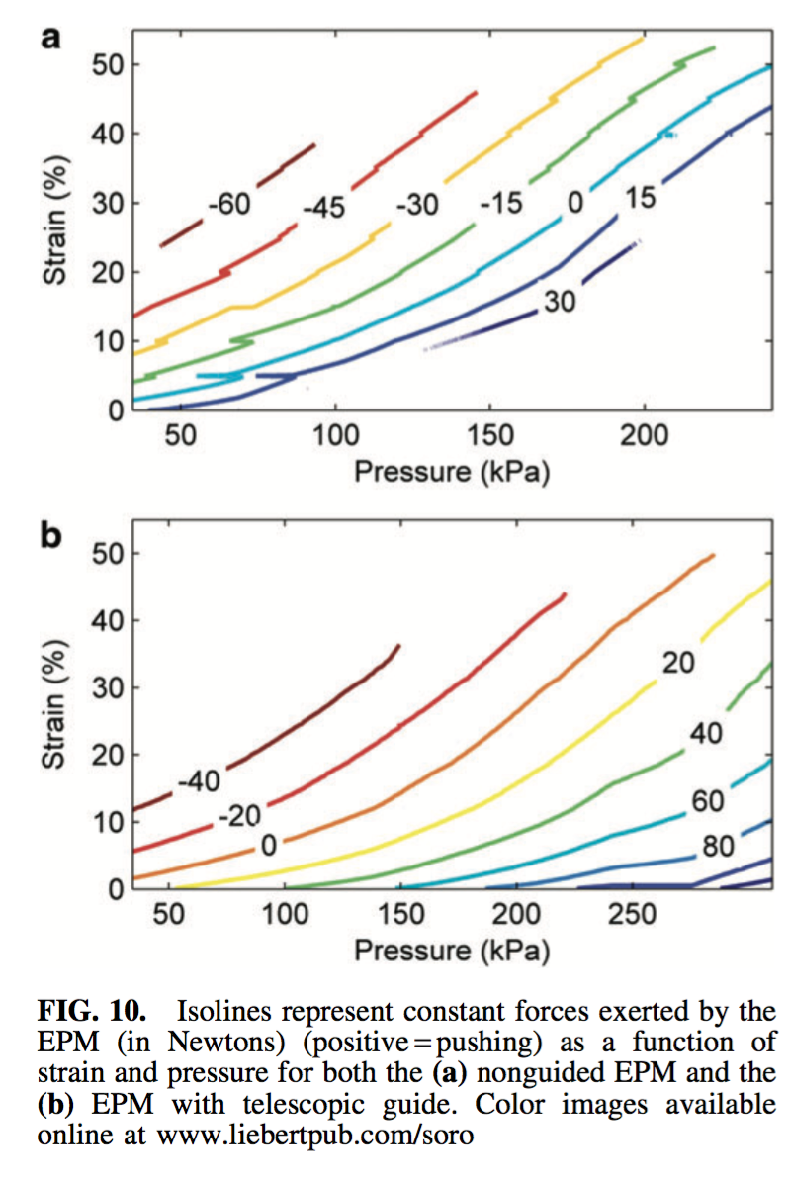
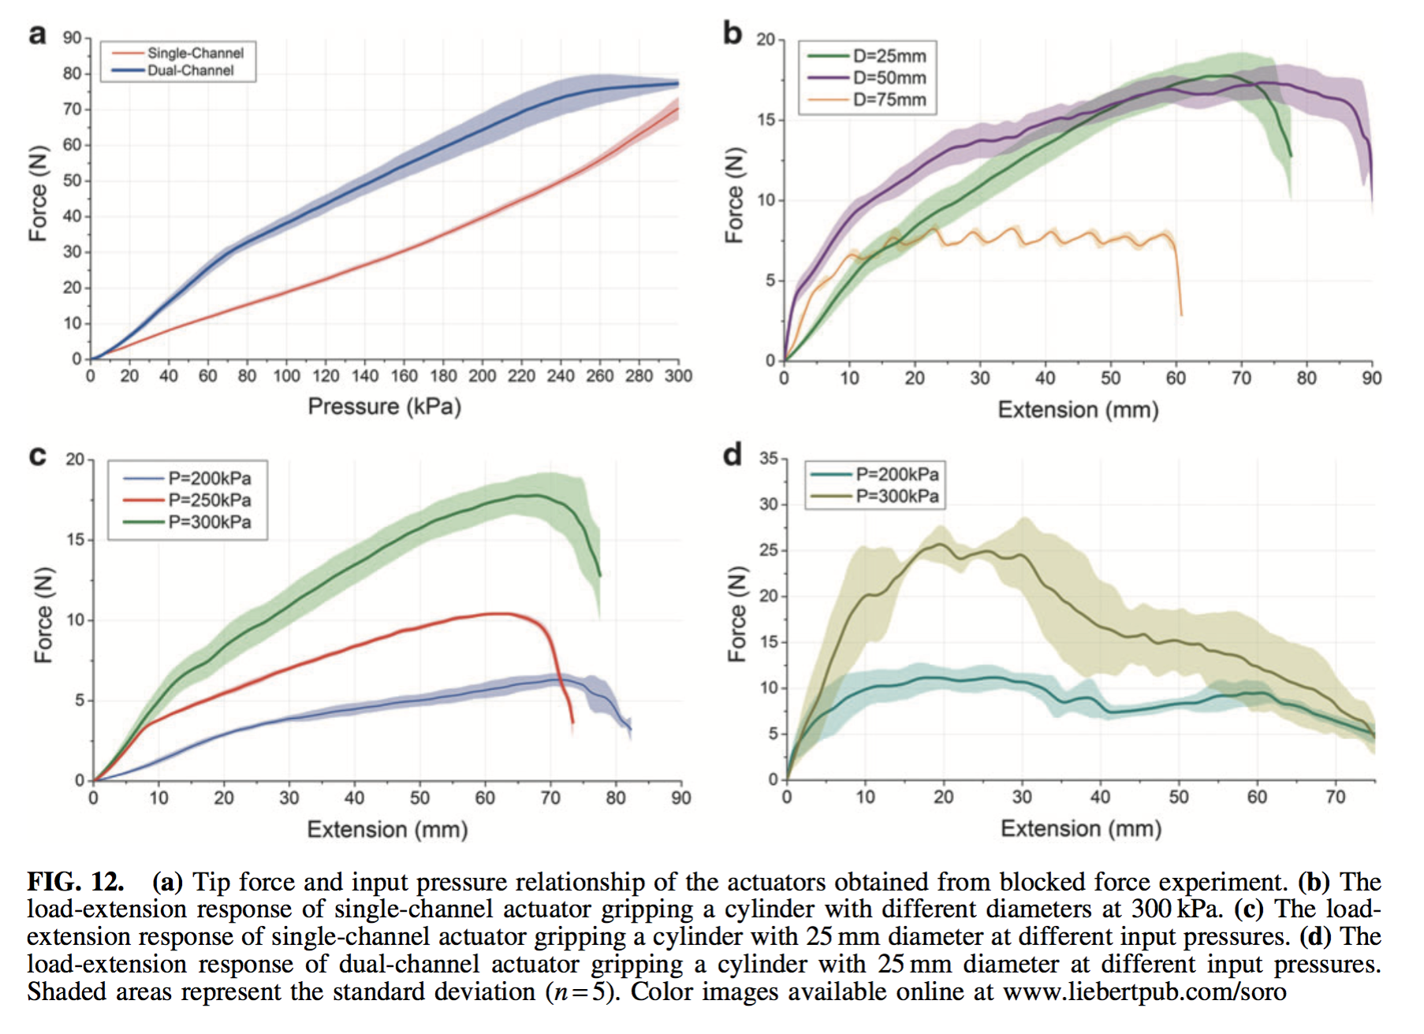
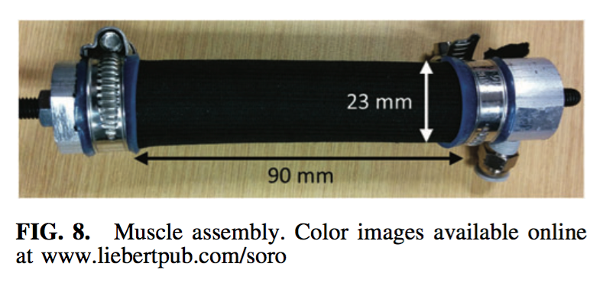
Dynamic response analysis. (a) The relationship of the tip force output and chamber pressure, for different preloaded pressure (and designs). (The tip force is measured while constraining the robot at 0 bending angle) Kinematics histories of the (b) step responses and (c) frequency responses of the robot.
Examples for (a)

Slide 19
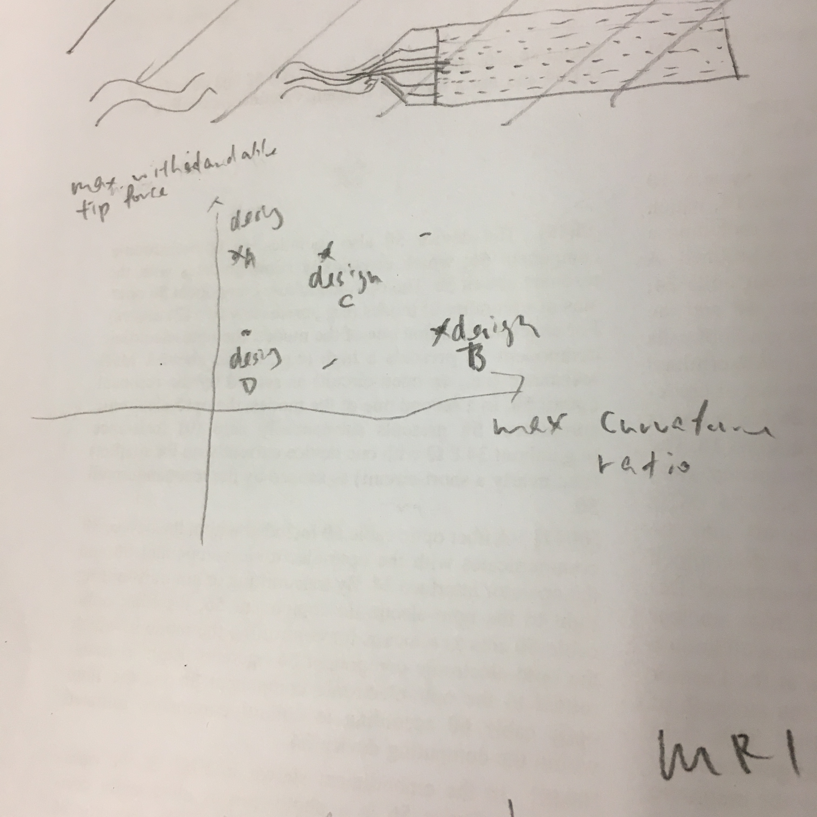
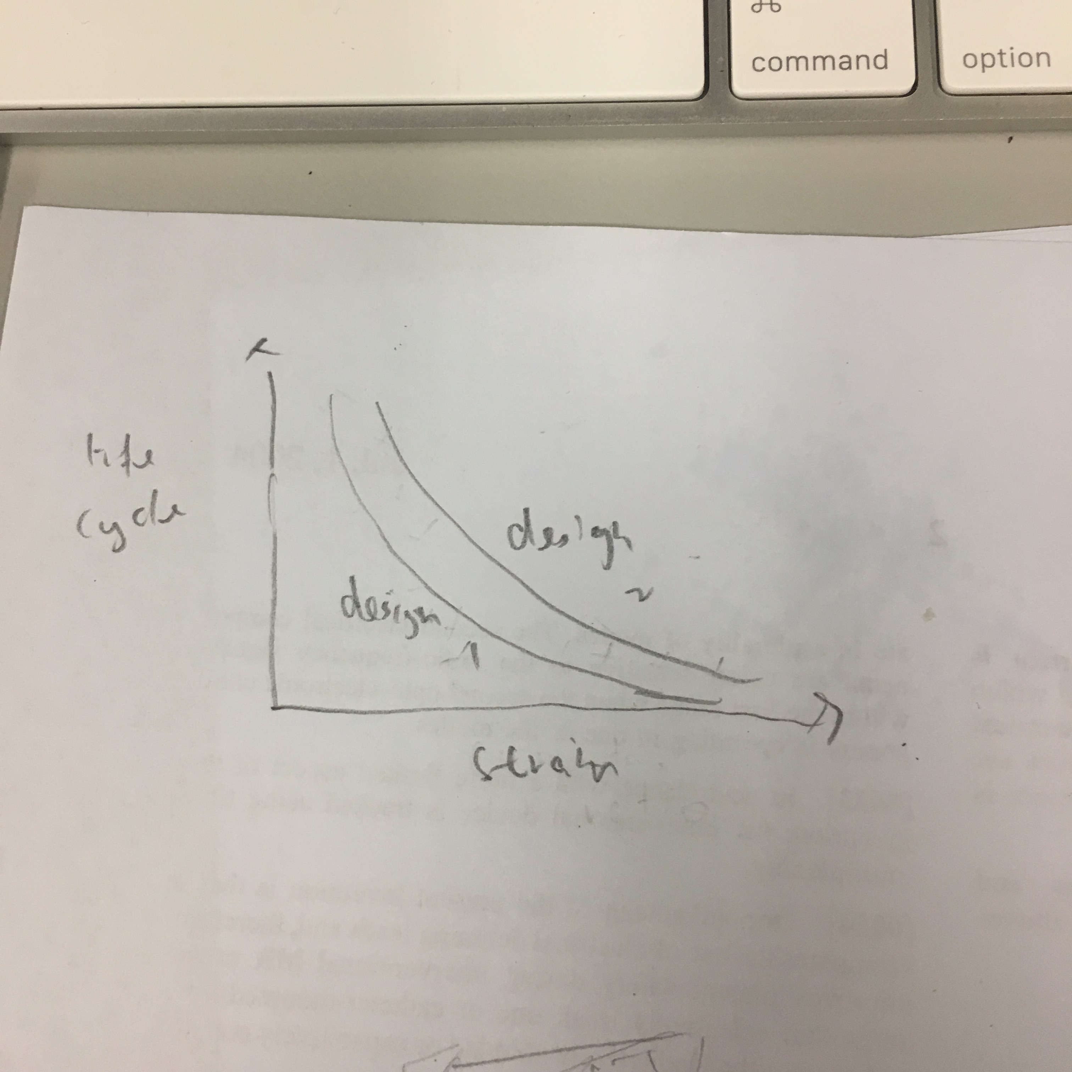
Performance limits of the prototype for different preloaded pressure (and designs). (a) Stiffness vs max. curvature ratio. (b) Life cycle.
Scope limitations
Fatigue -- life cycle vs engineering strain
max. curvature vs stiffness (max tip force to displace the tip)
Different preloaded pressure
different designs

Slide 20
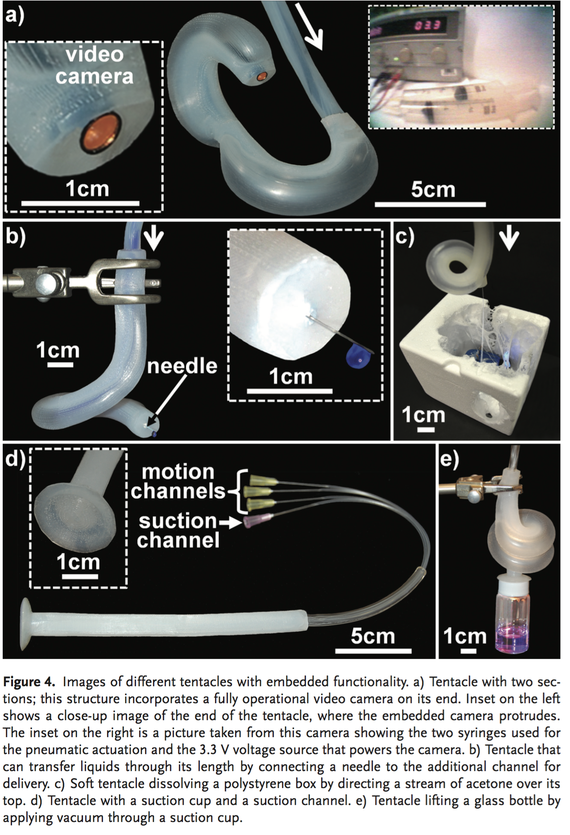
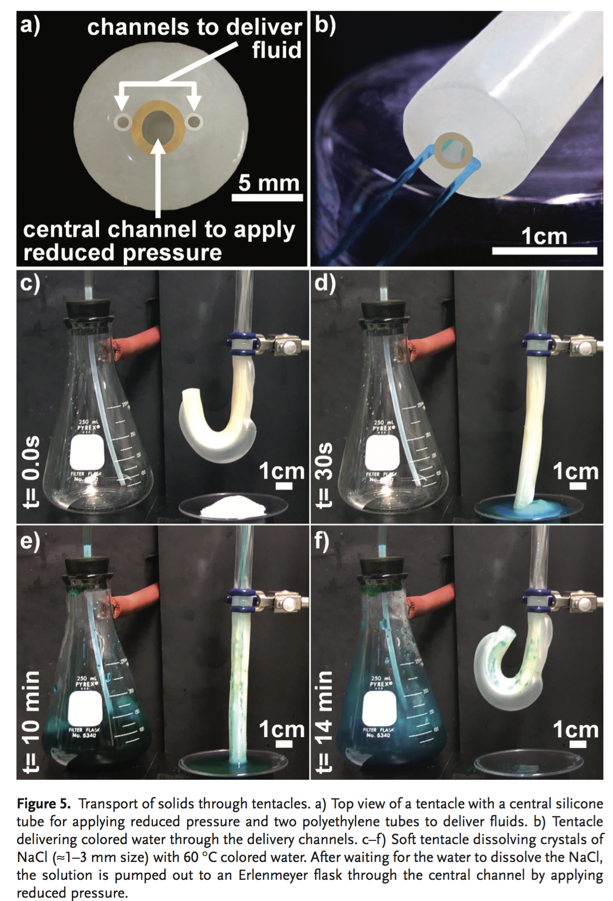
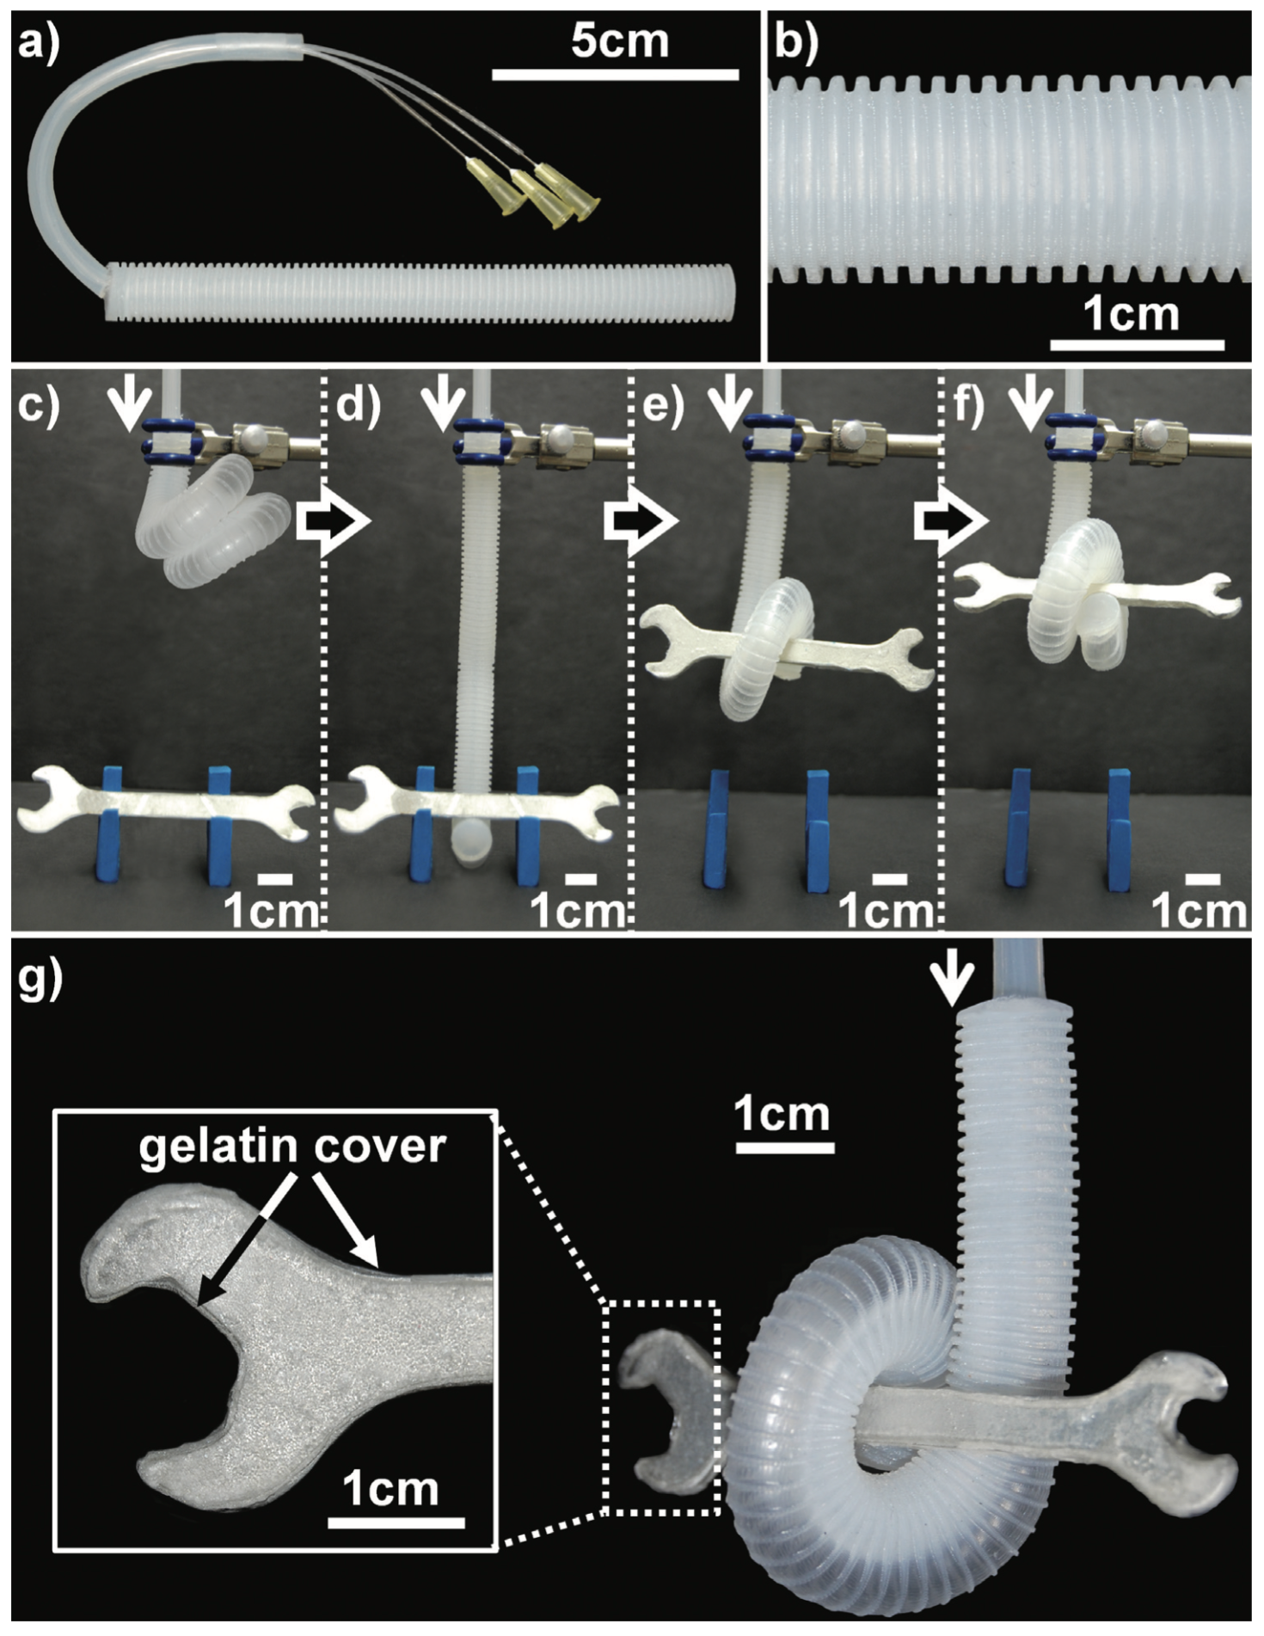
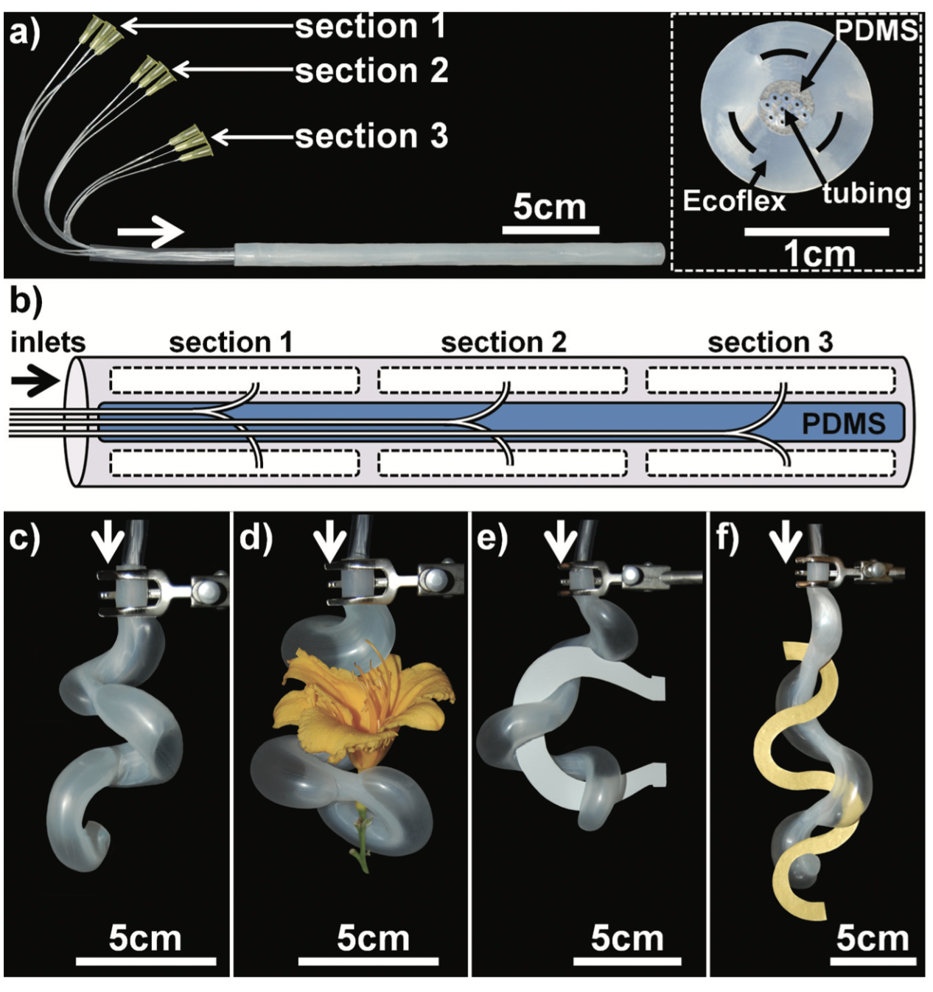
Demonstration of the basic function of endoscope
Camera: endoscopic view
Suction
Irrigation
Insufflation
Etc..
Basic functions of the prototype. (a) Endoscopic view when performing a biopsy task inside a phantom model. (b) Suction and (c) Irrigation of colored liquid. The demonstrations can also be found in the provided videos.

Slide 21
FEA animation
animation of bending
animation of adding force at the tip
Videos of real robot motion
bending behavior alongside of FEM animation
bending at different angles
sweeping
Stiffness
tip force required until tip displacement
lifting a mass
Endoscope functions
alongside with an endoscopic view
suction and irrigation of colored liquid
working with biopsy forceps

